Slide 1
Early childhood development: securing our human capital foundations for inclusive sustainable development
Presentation: Patricia Martin
NECDA conference
9 June 2023

Slide 2
Long history of global and regional commitments by governments to increase investments and universalise ECD
2015 SDGs: By 2030, all children will have equitable access to quality early childhood development and early learning opportunities
Incheon Declaration
Convention on the Rights of the Child and General Comment Nr. 7
African Charter on the Rights and Welfare of the Child
Continental Education Strategy for Africa
African Union Agenda 2063
Africa’s Agenda for Children 2040
Global Partnership Strategy for Early Childhood 2021 – 2030 (UNESCO)
Call to Act Together (UNESCO)
Nurturing Care Framework for ECD
Tashkent Declaration
TES Summit Declaration 2022

Slide 3
Critically: Governments are the responsible agents and have committed to direct public resources to change outcomes for young children to change national trajectories
SDG 4.2.1 The proportion of children aged 24 – 59 months that are developmentally on track in terms of health, learning and psycho-social wellbeing
SDG 4.2.2 Participation rate of children in organised learning by sex in one year of pre-school
Especially among historically marginalised families and communities
To lay solid human capital foundations
Increase the Human Capital Index – a measurement of progress in children’s achievement of their full potential
To ensure the long-term development of the health, knowledge, skills and resilience of all, especially the chronically marginalised to achieve transformation and inclusive, sustainable development

Slide 4
How is early development equalised and optimized to build human capital?
Formula is simple
Science is clear
Legal basis is clear on the implementation commitments
All captured in the global Nurturing Care Framework

Slide 5
Nurturing care for development requires
Health and nutrition
Responsive caregiving, safety and protection
Opportunities for early learning
Children develop to their full potential
The right ingredients
In the right combinations
Correct quantities
At the right time
Using the right instruments
Provided by experts
To meet the special needs of children
Mandated (implicitly) by legal and development instruments …

Slide 6
Like baking a cake: the ingredients of nurturing care on their own are not enough
Eggs
Flour
Milk
Sugar
Baking powder
Cocoa
Icing sugar

Slide 7
Even if you have all the ingredients, but not the recipe and do not know what and how many you are baking for will fail
But a recipe without the resources needed to produce a good product is not any good
Need to all know what a good product looks like and how you know if you have baked a good product
Need to know how to bake in the right quantities and combinations
Need to know what you are baking, for who and how many

Slide 8
What is required to achieve these outcomes?
Government-wide prioritisation and implementation of its ECD treaty and development commitments to achieve a shared goal all aspire and relate to – sustainable, inclusive development

Slide 9
National Integrated Multisectoral ECD policy and Programme/ Recipe
Multi-sectoral support across the life cycle of every young child
Universal basic services
Services in appropriate combinations to address risks faced by families
Specialised services for children at higher risk
Sustained quality services across five domains
To enable parents, families and caregivers to provide the nurturing care needed
Integrated programmes to reach all and provide
Global treaty and development commitments create a duty on governments to realise early child development
Regional and sub-regional commitments implicitly obligate equal and optimal ECD
Nurturing care framework harnesses evidence and provides guidelines on how to fulfil the implementation responsibilities
Aligned sectoral policies – health, education, protection, wash, social security

Slide 10
It is for this reason that optimal early development cannot be achieved without a supporting system
The Nurturing Care Framework therefore calls on government to develop a national inclusive multi-sectoral public ECD system to operationalise the NCF to universal, sustained nurturing care
A system is built on the following foundational building blocks to provide leadership and a mandate to all role players to provide the services required to secure nurturing care through their aligned sector -systems
National multi-sectoral ECD policy that defines a shared ECD goal and a government-wide mandate
&
Aligned sectoral policies and laws
Integrated, inclusive ECD programme committing to provide combinations of services
Human resources for the development, delivery, monitoring and ongoing quality improvement of all services
Infrastructure to support the policy, system and programmes
Adequate and sustainable financial resources
Information management system for evidence-based planning, monitoring and evaluation of outcomes
National and sectoral leadership and coordination of ECD as a national development priority

Slide 11
Logic and essential requirements for public universal provision of ECD to equalise and optimise development
What does it look like and what are the levels of monitoring and measurment

Slide 12
Human capital for sustainable inclusive development increased
Every young child develops to their full potential
Health
Nutrition
Responsive caregiving
Early learning from birth
Safety and protection
Parents and other caregivers access combinations of services and are enabled to provide nurturing care
Health services: promotive, preventative and therapeutic | Nutritional support | Parenting / family support and services | Age-differentiated early learning services from birth | Birth registration Child protection Basic services
Health ministry
Nutrition and food security
Social development
Education
Gender
Disability
Labour and social protection
Local government
Water and sanitation
National public ECD system that ensures all ministries recognise ECD as a priority and direct their resources to provide services in required combinations

Slide 13
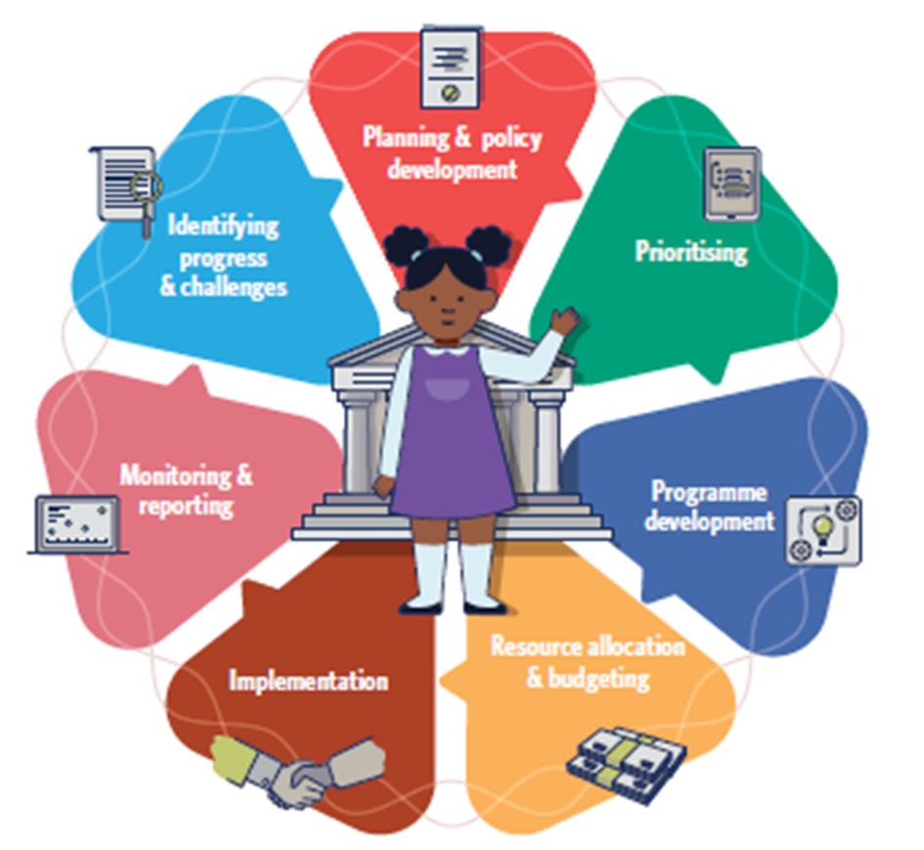
What is the purpose of the ECD system?
To secure government-wide ECD-centred governance
Government-wide prioritisation and actioning of ECD through coordinated planning, resourcing, monitoring and accountability for services and improved outcomes for children

Slide 14
Government-wide implementation of commitments requires a public ECD system that ensures coordination of sectoral systems to advance ECD as a shared national priority
Strategic plan
Information management system
Social Development ministry
Strategic plan
Information management system
Ministry of education and all other ministries
Strategic plan
Annual performance plan
Budget
Human resources plans, systems and capacity development
Infrastructure
Information management system
Annual performance plan
Programmes
Programmes
Budget
Infrastructure
Annual performance plan
Programmes
Budget
Infrastructure
Health ministry recognises ECD as development priority mainstreams its responsibilities
Human resources plans, systems and capacity development

Slide 15
What does this look like?
Within our governance architecture?

Slide 16
National and sector leadership and coordination mechanisms ensure government-wide prioritisation, compliance and accountability for inclusive ECD
All sector budgets support implementation of inclusive ECD programmes
All sector human resourcing plans support inclusive programmes
All sector information management systems monitor inclusive ECD coverage, quality and impact
All sectors all report on inclusive ECD responsibilities and improved outcomes
Follow-up / quality improvement processes to strengthen systems and improve outcomes for children with special needs
All sector policies and laws mandate programmes and resources for providing inclusive ECD services
All sector plans operationalise commitments to provide inclusive ECD services across all 5 components
All sector programmes delivery quality, integrated inclusive ECD services
Recognition of ECD as a national rights-based development priority by Presidency and a state-wide duty to advance an account for using resources to advance improved outcomes for young children – clear shared ECD goal in the NDP, MTSF and SONA

Slide 17
ECD: Taking stock with 7 years to go to 2030
How well are we doing in the region and South Africa in realising ECD commitments and improved outcomes?

Slide 18
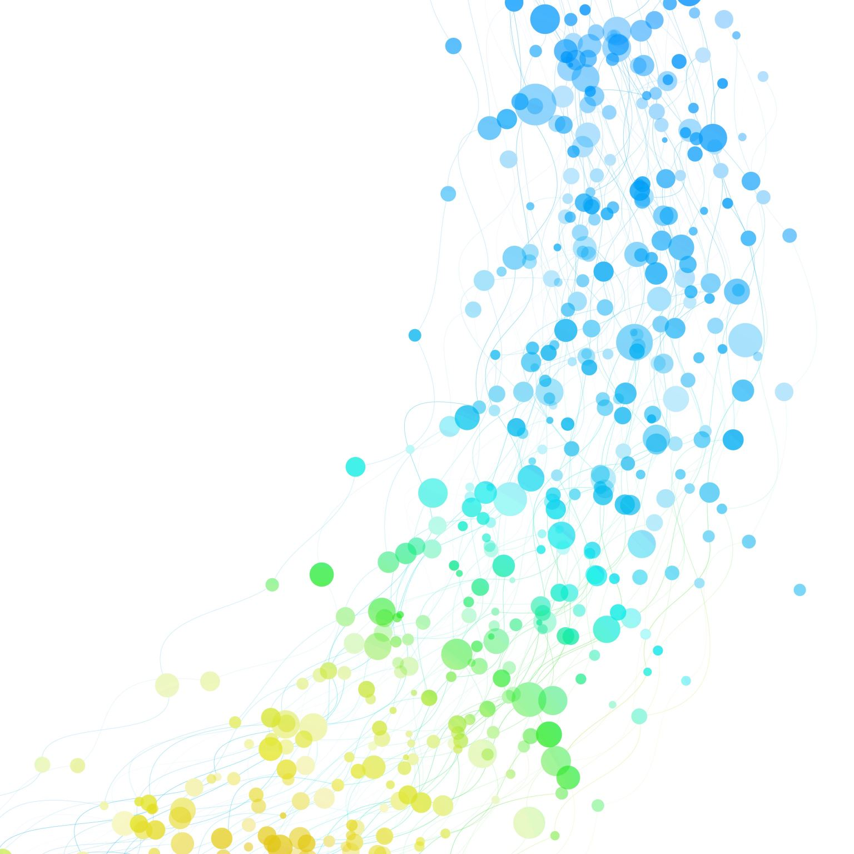
World Banks Human Capital Index
Measure of extent of children’s development and a good proxy for ECD progress – viewed holistically – and in terms of how well we are doing in strategic ECD to build human capital

Slide 19
“On average, African children born today can expect to achieve only 40% of their potential productivity by their 18th birthday” (World Bank, 2021)
Poverty
Malnutrition
Stunting
Poor health
Poor learning outcomes
Child marriages
Adolescent pregnancies
Why?
Nurturing Care has not been systemically enabled per the Nurturing Care Framework
Intergenerational development patterns fueled by worsening social and economic context
Because systems are weak

Slide 20
Mozambique | 0.36 | Common underlying causes: Human capital complementary indicators – measure progress in intermediate outcomes determining - indicating need for investment at different stages to improve HCI ECD indicators are poor in low scoring countries because: NNMR Adolescent birth rates High levels of avoidable disability / cognitive and physical limitations that can last a life time High stunting Poor access and quality early learning Where outcomes are better: In health for example, in Malawi – because the health system has strengthened Population scale programmes – antenatal health care coverage, birth registration
Angola | 0.36
DRC | 0.37
Eswatini | 0.37
Madagascar | 0.39
Tanzania | 0.39
Zambia | 0.40
Malawi | 0.41
Botswana | 0.41
South Africa | 0.43
Namibia | 0.45
Zimbabwe | 0.47
Mauritius | 0.62
Seychelles | 0.63

Slide 21
South Africa is not doing better than the region
Despite the adoption of an integrated ECD policy almost 10 years ago that commits to operationalising the Nurturing Care Framework and provides the road map to do so
Despite a deliberate pro-poor policy and increased health and education budgets (World Bank, 2021)
South Africa’s Human Capital Index (HCI) has not changed in 10 years. A child born 10 years ago would only develop 43% of their potential.
Most at risk are historically marginalised
Development and exclusions start early in life
Fuels lifelong trajectory and patterns of exclusions and inequalities
Stunting has increased - almost ¼ of children under 5 affected
Only 1/3rd of under 5’s are developmentally on track (Thrive by Five, 2022)
80% of children in Grade 4 cannot read for meaning (Spaull, 2023)
NEET rate – not in education, employment or training is more than 30% and increased over the last 10 years. 1/3 of young people remain chronically excluded.
These are the parents of the next generation, who, unless we change the story now, will be born into greater adversity and less capacity for nurturing care
Breaking this cycle requires improving development of children at population scale

Slide 22
Why are we seeing this in the region and in South Africa?
We adopted the ECD policy, committing to implement our obligations by establishing a robust ECD system, but have not followed through

Slide 23
Human capital for sustainable inclusive development increased
Every young child develops to their full potential
Responsive caregiving
Health
Nutrition
Early learning from birth
Safety and protection
Parents and other caregivers access combinations of services and are enabled to provide nurturing care
Health ministry
Local government
Health services: promotive, preventative and therapeutic | Nutritional support | Parenting / family support and services | Age-differentiated early learning services from birth | Birth registration Child protection Basic services
Education
Labour and social protection
Social development
Gender
Water and sanitation
Nutrition and food security
Weak public ECD systems designed around realising ECD as a shared, national development responsibility
Disability

Slide 24
Leadership
Do we have a measurable shared, outcomes-based ECD goal – such as improve the HCI, improve the Thrive by Five index?
Is it referenced in the NDP, MTSF, SONA? SOPA and IDPs?
Do we measure progress and report on this during annual and mid-term reviews – as a country?
Coordination
Do we have real coordination in the sense that all sectoral systems are aligned to recognise and contribute to the achievement of the shared goal?
Do we have inter- and intra-sectoral alignment?
Is ECD governance embedded in the governance architecture established to drive government-wide actioning of all other SDGs?
Programmes at scale in combination to address out biggest risks?
Micronutrient supplementation of all girls of child-bearing age
Integrated ECD – 5 pillars per the RtHB – in the public health system to enable nurturing care at all contacts with pregnant women, infants and babies in the 1st 3 years
Sustainable, transformational parenting programmes at scale addressing responsive caregiving, positive parenting, nutrition – for example – through the education system
Mental health care for pregnant women and new mothers
Routine screening and referrals for violence, abuse and substance abuse
Stunting

Slide 25
Human resourcing
Do we have the capacity – across the governance continuum – for ECD-centred governance? Leadership, coordination and evidence-based planning, resourcing, monitoring and accountability across the governance continuum, in:
The Presidency
DPME
Provincial Premier Offices
Local Mayoral Offices
All ministries – not just DBE, but health, environment, women Parliament
Financial resourcing
Has there been a shift in resourcing policies and priorities to address our biggest gaps – earliest years, nutrition, responsive caregiving
Is there resourcing coherence to support a coherent system and integrated ECD provisioning
Recent resourcing assessment by World Bank et al – found that they could only assess allocations and improved allocations for services after the age of 3 and then primarily for early learning
Have we seen shifts in resourcing to balance provisioning and enable nurturing care through the public health system and community outreach programmes?
Information management, data analysis and reporting
Do we have a shared ECD goal
Is it measurable and measured
Is it in the MTSF
Is it mainstreamed across all sector IMSs?
Are we measuring outcomes and systems strengthening progress - not just inputs?

Slide 26
What will it take to bring about change?
To fundamentally strengthen a national ECD system across all components?

Slide 27
Government-wide understanding, action and accountability through ECD-centred governance
This however fundamentally depends on high level ECD leadership, guidance on implementation responsibilities and how to fulfil them, coordination, and accountability at global, regional and national levels

Slide 28
Coordination and aligned implementation for improved outcomes is not possible without effective leadership
Global
Regional
National
Sectoral

Slide 29
To shift resourcing, to shift programming, to shift systemic human resources developing is a political ask
It must be led from the top as a period of development dependent on a whole of government response – not just ECE
Will not happen without high-level, credible leadership of ECD – and a very specific national ECD goal – as a national, rights-based development priority
By the Presidency, Premiers, Mayors (and ultimately the politicians)
In the NDP, MTSF, SONA
This is what determines government-wide planning, prioritisation, monitoring and accountability
We have changed our coordination arrangements without strengthening leadership
With respect, DBE is an administrative structure, not a political leader. Expecting the function shift to catalyse the systemic changes we need to see is not realistic

Slide 30
To get this we need…
SMART advocacy
Strategic, specific, timely, relevant
For improved early development outcomes as a national development priority
Led by the Presidency
Embedded in the national governance architecture that drives all other development goals
It requires long-term, sustained, multi-sectoral advocacy
Which can only be done collectively through alliance structures
It works and it can work better now.
The time is right
We have a window of opportunity that will not be open for another decade or more if we miss it

Slide 31
It worked for driving the ECD changes we have seen
Improved access to ECD centres – infrastructure grant, conditional grant programme
2 years publicly provided early learning – Grade R plus universalisation
Function shift to DBE
Measured, Monitored, Reported, Understood
But it has not been enough to change the end of the story for young and older children
Need to see the same shifts across all domains and strengthening of the national system
To improve early outcomes
Will only happen if we advocate for very specific, SMART, carefully chosen catalytic asks
Now, as the world is taking stock of its slow / no progress on SDGs
Emphasis on science of 1st years
And as we move out of our long term plan to the next NDP and out of the current Medium Term Planning Framework to the next
Make sure we have the right priorities, framing and mandate in the next NDP, the next MTSF to provide leadership that will catalyse government-wide coordination

Slide 32
Is NECDA up for the challenge?
Thank you

